Slide 1
Public Hearing on CERC draft proposal for determination of value of “X”
03.12.2025

Slide 2
CERC Proposal for determination of value of X
As per CERC DSM Regulations 2024 the revenue neutral deviation bands will be reduced by 5% for WS seller w.e.f 01.04.2026 and “X” factor will be incorporated in % deviation calculation for WS seller. Value of ‘X’ shall be stipulated by the Commission through separate order(s) after public consultation.
In this regard, Hon’ble Commission has published a draft proposal for determining the value of “X” for calculating deviation (in %) for Wind and Solar (WS) Sellers via Petition No. 9/SM/2025 (Suo-Motu) dated 10.09.2025 and invite all stakeholder to submit their comments.
Commission proposed trajectory for reduction of “X” shall be as follows:
Further Hon’ble Commission has also directed its staff to initiate the process of amendment of DSM Regulations, 2024 for the following:
1. Existing WS projects shall be treated at par with General Sellers (Conventional) from 01.04.2031 onwards.
2. New WS projects, with tendering or bid submission date on or after 01.04.2026 shall be treated at par with General Seller.
3. No payment shall be made of existing WS sellers for over – injection during period when system frequency is on or above
50.05 Hz.
Period | Value of “X”
01.04.2026 – 31.03.2027 | 100%
01.04.2027 – 31.03.2028 | 80%
01.04.2028 – 31.03.2029 | 60%
01.04.2029 – 31.03.2030 | 40%
01.04.2030 – 31.03.2031 | 20%
From 01.04.2031 onwards | 0%

Slide 3
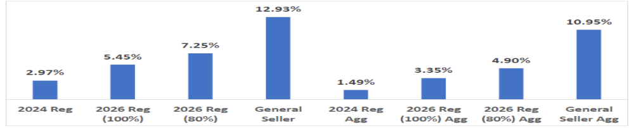
Key Highlights of the proposal:
Hon’ble Commission has analyzed the impact of reduction in deviation bands and X factor for 16 RE plants (Solar 6, Wing 6 and Hybrid 4) spanning all regions using the data from 16.09.2024 to 29.06.2025. The results are as follows:
Impact of value of X without aggregation and with aggregation
RE Generating station | Existing Tolerance band | % Time within band | New Tolerance band | % Time within band | % Gain / Loss w.r.t. PPA rate due to DSM
 |  |  |  |  | X = 100% | X = 0%
Solar | +/-10% | 74% – 84% | +/-5% | 45% – 58% | 3.5% | 11.1%
Wind | +/-15% | 73% – 93% | +/-10% | 32% – 73% | 2.8% | 48.2%
Hybrid | +/-10% | 72% – 87% | +/-5% | 38% – 47% | 2.4% | 11.8%

Slide 4
Key Highlights of the proposal:
Hon’ble Commission has given following rationale to align deviation criteria of RE Generators with those applicable to conventional generators:
India's ambitious goal of achieving 500GW of renewable energy installed capacity by 2030 underscores the need for stricter deviation criteria to ensure grid stability. As renewable energy plays a larger role in the energy mix, grid security becomes increasingly critical.
Large tolerance band coupled with relaxed error / deviation formula would have a serious operational impact on grid management.
Transitioning to a schedule-based deviation mechanism is essential for mitigating these risks.
Wind / Solar are considered as matured technologies. As the share of variable RE expands, transitioning to schedule based deviation framework is critical to maintaining grid security and ensuring reliable power supply.
Efforts being made by various institution and agencies for advancement in technology and availability of real time data on wind speed and cloud coverage will improve ability to predict generation levels and further reduce margin of error.
Aggregation can be adopted by WS sellers at pooling station reduces the impact of DSM charges significantly.
Renewable energy developer, have adopted all available advanced technologies to enhance forecasting accuracy. However, despite these efforts, significant deviations (forecasting errors) are still being observed, and the is also mentioned by Hon’ble CERC in their draft proposal.
In this regard, we would like to present the challenges and limitations of current forecasting technologies in achieving the proposed accuracy levels for kind consideration of the Hon’ble Commission.

Slide 5




Integration of Advanced Technologies to improve Forecasting Accuracy:
Various initiatives taken to improve Forecasting Accuracy
Increased no of Data Sources
01
02
International Collaboration
Integrated High Resolution Global (ECMWF) and Indian weather models (NCMRWF)
Integration of real-time measured values from SCADA for bias correction (IC & SFTP)
Integration of Satellite derived forecast with European vendors using Cloud Motion Vectoring for Intraday
Integrated AI technology developed by Switzerland based company for wind forecast.
Integrated NWP+ Satellite data+ On-site data ingestion developed by France based company
POC with Thailand based company for evaluation of AI/ML based models
Collaboration with National agencies
In-house efforts
Collaboration with IITM, Pune for Bharat Forecast System (latest weather model)
Collaborated with startups incubated by IIT Mumbai for wind forecast
Augmented manpower for 24*7 operations (365 days)
Back testing tool for wind and solar power forecast
Implemented ML based model for fog forecast
Installed All Sky Imager, visibility sensor, automatic weather observing station(AOS)
03
04

Slide 6
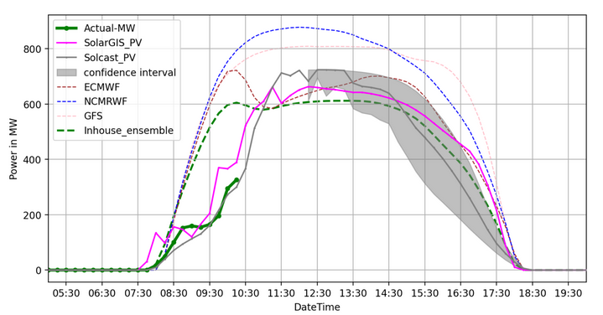
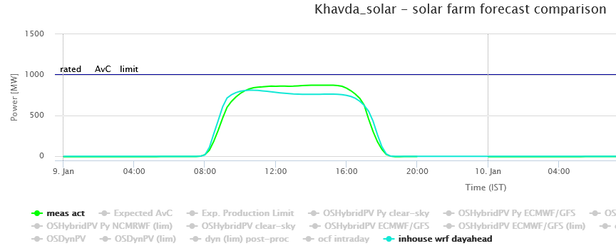
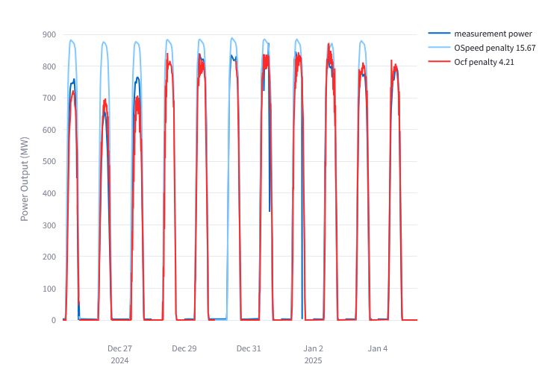
Short Term Forecasting – Technical Approach:
Data & Sensors
Integrated NWP & satellite-based forecast of SolarGIS and Solcast data Integrated visibility meter for fog detection Integrated sky-imager for real-time cloud monitoring Integrated AWS for improvement of wind-power forecast
Hyper-local Weather Models
Hyper-local WRF with 1.6 km resolution operational for day-ahead The model is consuming input from multiple global weather sources
Deep Learning Models
Deep-learning model based intraday forecast is generated for solar & wind Scaling them to all in-house farms
WRF model output in STF GUI
Deep learning model output for solar plant

Slide 7
Key Challenges in Weather Forecasting: India vs. Mid-Latitudes (with seasonal context) :
Aspect | India (Tropical Monsoon) | Mid-Latitudes (Europe/US)
Seasonality & Variability | Highly monsoon-driven with abrupt transitions; active/break cycles (June–Sept) | Predictable seasonal cycles (summer/winter) with gradual transitions
Cloud & Irradiance Behavior | Rapid convective cloud formation, localized thunderstorms (Pre-monsoon: Mar–Jun; Monsoon: Jun–Sept); aerosol/dust events (Mar–Jun, Dec–Feb) | Stratiform cloud systems dominate (Winter: Nov–Mar)
Wind Patterns | Strong diurnal sea-breeze effects (Apr–Sept), sudden gust fronts, monsoon lows (Jul–Sept) | Jet stream-driven systems; frontal passages (Winter/Spring: Nov–Apr)
Forecast Horizon Reliability | Day-ahead forecasts degrade during active/break monsoon phases (Jun–Sept) | Day-ahead forecasts relatively stable year-round
Data Gaps | Sparse radar/aerosol network year-round | Dense observation networks year-round
Extreme Events | Cyclones (Apr–Jun & Oct–Nov), monsoon depressions (Jul–Sept), heatwaves (Mar–Jun), dust storms (Apr–Jun) | Winter storms (Nov–Mar), heatwaves (Jun–Aug), wildfires (Jul–Sept)
Aerosols & Humidity | High aerosol load (dust: Mar–Jun; haze: Dec–Feb), high humidity (Jun–Sept) | Aerosol impact minor; humidity less variable
Topography Influence | Complex terrain effects year-round (Western Ghats, Himalayas) | Terrain effects moderate year-round

Slide 8
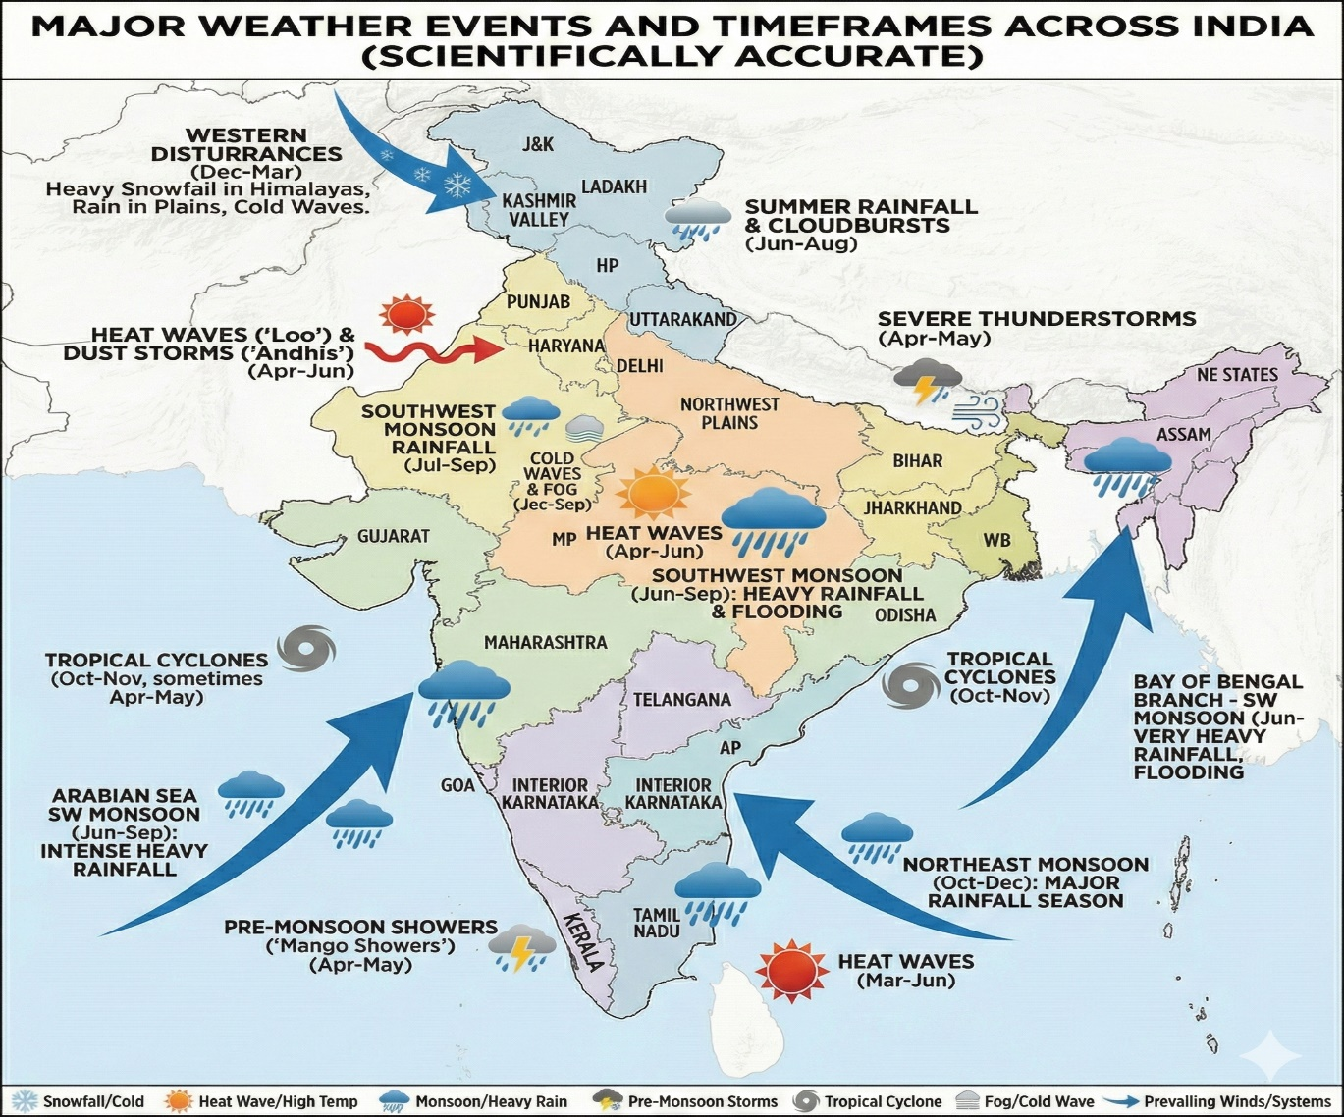
Key Challenges in Weather Forecasting: India (with seasonal context) :

Slide 9
Submission:
RE generation being variable in nature is dependent of weather conditions and cannot be predicted accurately on day ahead basis and generation control is impossible in real time.
RE deviation needs different treatment than conventional source (general seller) and such proposal to align them will only increase the financial burden on RE developer.
Till the forecasting technology improves such changes in RE deviations should be deferred as it will only bring financial stress in the sector instead of the intent to act as a deterrent.
The significant financial burden will increase the RE tariffs and may also affect in achieving target of 500 GW by 2030 as it is proposed to treat new RE capacity at par with general seller.
Aggregation of multiple ISTS substations needs to be allowed and stabilized before implementation of such proposal.
The financial impact of DSM is notably higher when deviations occur outside the permissible frequency band of 50.05 Hz. As control of RE generation is not possible, this proposal needs to be reconsidered to avoid undue burden on generators.
Additional charges such as RTDA, congestion charges and RTA for import of power, already imposes financial stress on RE generators. Further reduction in DSM bands and the introduction of an “X” Factor will again increase the financial burden, potentially impacting the viability of RE projects.

Slide 10
Submission:
RE generation capacity selling power in Exchange(s) will be severely impacted as intra day revision of schedules is not permitted.
Battery storage requires time for commercial maturity and large-scale deployment. A comprehensive review of deviation bands should be undertaken following the reasonable integration of energy storage technologies (ESS).

Slide 11


Thank You

